Slide 1

Welcome Back
Lab 5-
Ecommerce & Tips for Selling Products Online

Slide 2
Lab 5
Expectations
Chat Support Available During Webinars
Knowing Your Resources
Webinar Process
Facebook Support
Search: Crexendo UP Website Competition
Online Resources
up.Crexendo.com/unr

Slide 3
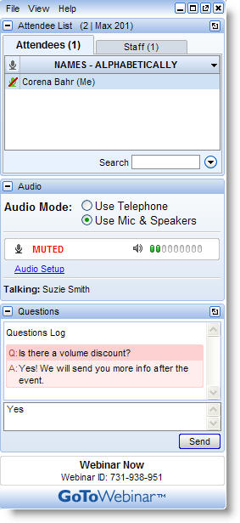
Lab 5
Live presentation
Attendees are muted
Type your questions in the “Questions” window
Questions answered live or via chat reply

Slide 4

Lab 5 Review
Webinar 4 Review
Writing Copy
Categories
Taxes & Ordering Rules
Publishing
Products
SEO Keyword Map
Writing Copy
What Search Engines Want
What Visitors Want
Domain Research and Registration
Q&A

Slide 5
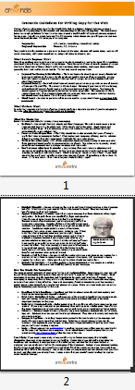
Lab 5
Webinar 4 Review
Writing Copy
Categories
Taxes & Ordering Rules
Publishing
Products
Make your text “Skimmable”
Q&A

Slide 6
Lab 5
Webinar 4 Review
Writing Copy
Categories
Taxes & Ordering Rules
Publishing
Products
Where are the goods?
Adding a product
Uploading list by Spreadsheet
Price$
What are SKU doing?
Q&A

Slide 7
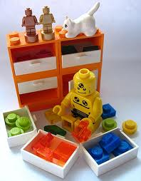
Lab 5
Webinar 4 Review
Writing Copy
Categories
Taxes & Ordering Rules
Publishing
Products
Categories
Why/What/Whom/Where
Sorting Products
Creating Categories and sub categories.
Q&A

Slide 8


Lab 5
Webinar 4 Review
Writing Copy
Categories
Taxes & Ordering Rules
Publishing
Products
Uncle Sam- Getting Taxes Linked
Adding Coupons into your site
Q&A

Slide 9
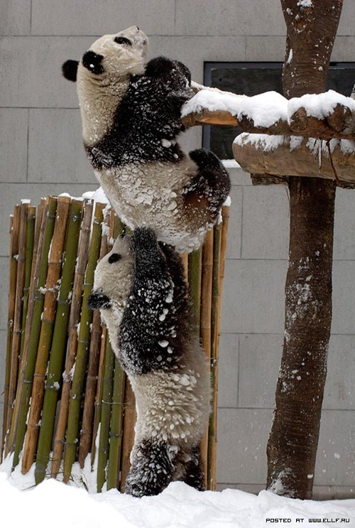
Lab 5
Webinar 4 Review
Writing Copy
Categories
Taxes & Ordering Rules
Publishing
Products
  Back Up
  Publish
  Restoring
Almost There
Q&A

Slide 10

Lab 5
Webinar 4 Review
Writing Copy
Products
Categories
Taxes & Ordering Rules
Publishing
Questions
Answers
Q&A

